Slide 1
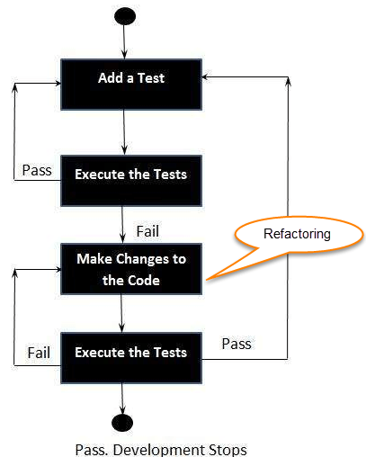
Test Driven Development
RED
Write a Test case which fail
GREEN
Write the simplest possible code to make it succeed.
REFACTOR
Refactor the code to meet the “4” principles of simple design.
Runs all tests
Contains no duplication
Expresses intent of programmers
Minimizes number of classes and methods
Repeat

Slide 2

Reasons Why Cloud Computing Is Important for Business Growth

Slide 3

Benefits of Business Analytics
Data-driven decision-making
Improved operational efficiency
Better customer insights
Competitive advantage
Predictive modelling

Slide 4
Open Web Application Security Project (OWASP)
Broken Access Control
Cryptographic Failure
Injection
Insecure Design
Security Misconfiguration
Vulnerable and Outdated components
Identification and Authentication failure
Software and Data Integrity Failures
Security Logging and Monitoring Failures
Server-Side Request Forgery

Slide 5
Concurrency
Scale out via the process model
Port Binding
Export services via port binding and it is self contained
Codebase
One codebase tracked in revision control & many deploys
Config
Store config in the environment
Logs
Treat logs as event streams
Processes
services are stateless and share-nothing
Disposability
Maximize robustness with fast startup and graceful shutdown
12
Factors
Dependencies
Explicitly declare and isolate dependencies
Build, release, run
Strictly separate build and run stages
Admin Processes
Run admin/management tasks as one-off processes
Backing services
Treat backing services as attached resources
Dev/prod parity
Keep development, staging, and production as similar as possible

Slide 6
#Customer Satisfaction
#Measure the Progress
1
7
2
#Accept Changes in requirement
#Sustainable Development
8
#Delivery value frequently
#Technical Excellence
3
9
#Work together
#Keep the work simple
4
10
#Build strong Teams and Environment
5
#Self Organized team
11
#Encourage Face-to-Face communication
#Reflect and Improve
6
12

Slide 7
dname
grade
sname
sex
cno
cname
sid
cno
sid
sectno
age
student
enroll
course
dname
year
gpa
dname
cno
section
major
sectno
pname
sid
dname
dname
dept
prof
pname
numphds
pname

